Slide 1
How to Restrict Editing Bibliographic Fields by Member Institutions of a Network Zone Consortium
Yoel Kortick
Senior Librarian

Slide 2

Agenda
Introduction
Accessing the configuration
For example
Using the prefix for the restriction of the 035 field

Slide 3
Introduction

Slide 4
Introduction
The Consortium Central Office (the Network Zone institution) can control which Bibliographic metadata fields can be edited by the Network Zone Consortium member institutions.
This can prevent unwanted edits of specific fields, and thereby help with the quality control and uniformity of the Network Zone records.

Slide 5
Introduction
In the example here we have a network zone and three member institutions:
Member / Network | Name | Inst. Code
Network | Ex Libris University Consortium | EXLDEMO2_INST
Member | Alma University | EXLDEV1_INST
Member | Open University | EXLDEMO3_INST
Member | University of Knowledge | EXLDEMO1_INST

Slide 6

Introduction
Network Zone
Ex Libris University Consortium
Member Institution
Alma University
Member Institution
Open University
Member Institution
University of Knowledge

Slide 7
Accessing the configuration

Slide 8
Accessing the configuration
The configuration to restrict editing bibliographic fields by Network Zone Consortium member institutions is done in the “Fields Restriction Policy” table.
This table can be accessed at the Network Zone institution as follows:
“Configuration > Resources > Cataloging > Metadata Configuration”
Select the relevant metadata profile (for example “MARC21 Bibliographic”)
Switch to tab “Other Settings”.
Select configuration table “Fields restriction policy”

Slide 9
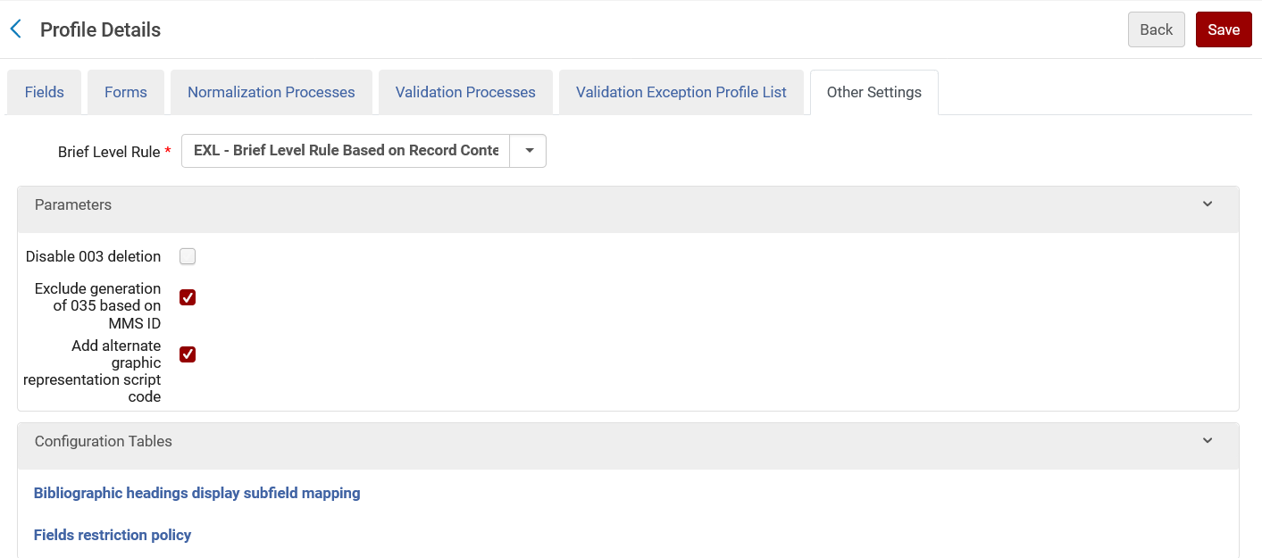
Accessing the configuration

Slide 10
For example

Slide 11
For example
The “Ex Libris University Consortium” has several member institutions, including:
  Alma University
  Open University
  University of Knowledge

Slide 12
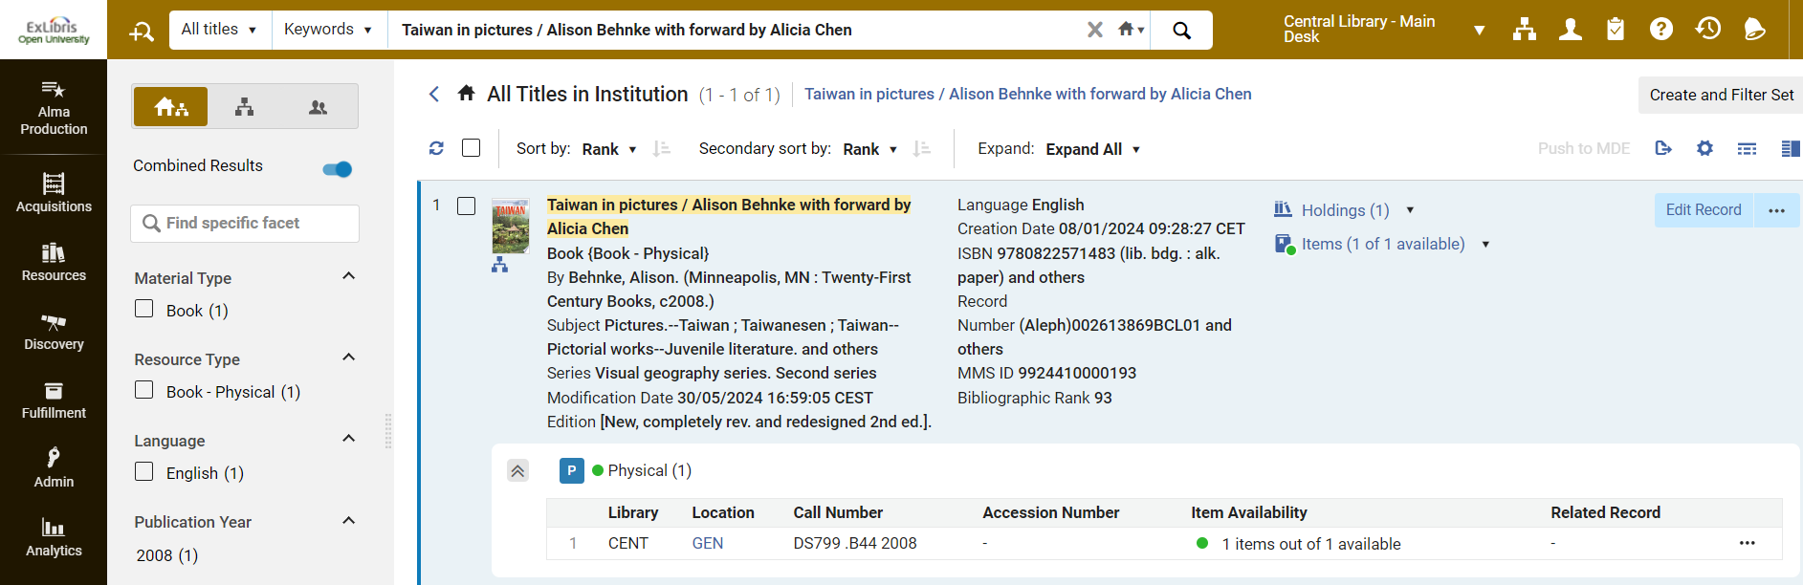
For example
Here is record MMSID 9924410000193 title “Taiwan in pictures / Alison Behnke with forward by Alicia Chen” in member institution “Open University”
At member “Open University”
Linked to network zone

Slide 13
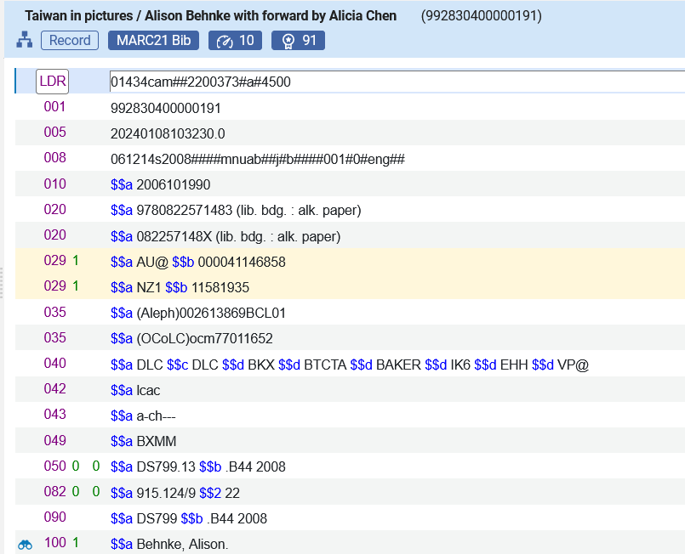
For example
Here is the record in the metadata editor (part 1 of 2)
We will prevent member institutions from adding, editing or deleting the 035 field. Now it can be added, edited and deleted.

Slide 14
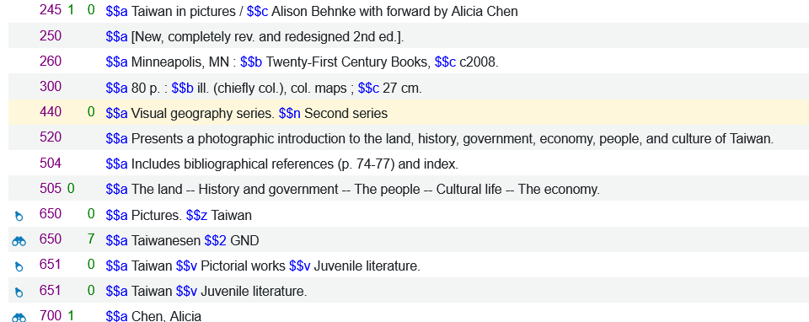
For example
Here is the record in the metadata editor (part 2 of 2)
We will prevent member institutions from adding, editing or deleting the 650 field when it uses vocabulary LCSH. Now it can be added, edited and deleted.

Slide 15
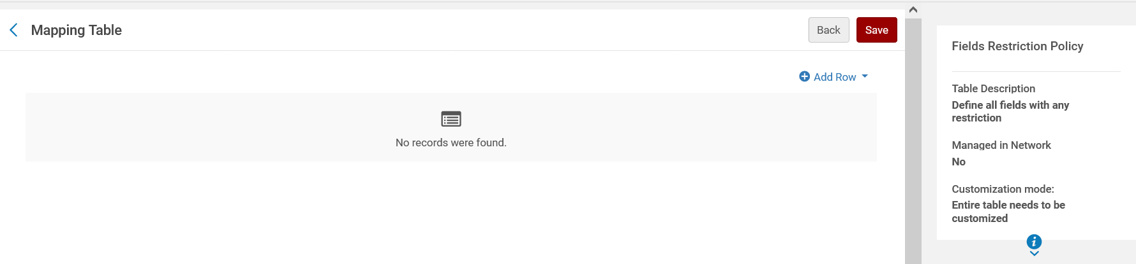
For example
In the network zone in the “Fields restriction policy” table we will add a row

Slide 16
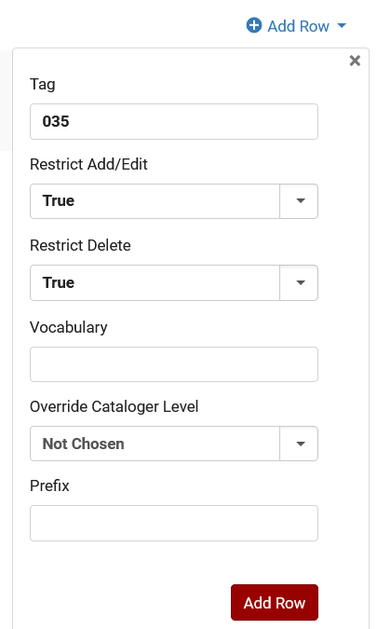
For example
Field 035
Cannot be added or edited
Cannot be deleted
Vocabulary is irrelevant for field 035
We will learn more about the Prefix soon

Slide 17
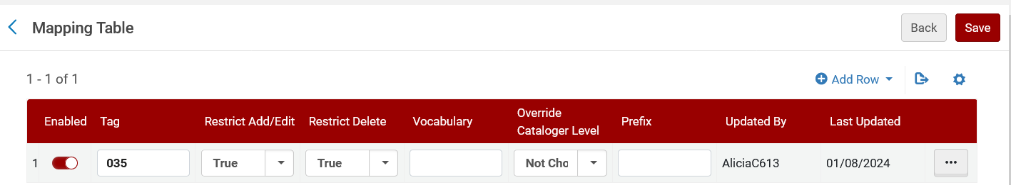
For example
Now we will add another row

Slide 18
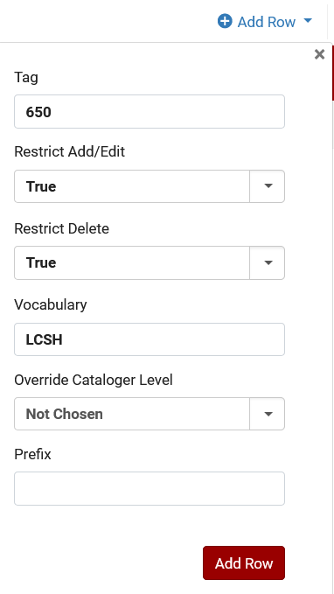
For example
Field 650
Cannot be added or edited
Cannot be deleted
Vocabulary is relevant only for field 650 (2nd indicator 0)

Slide 19
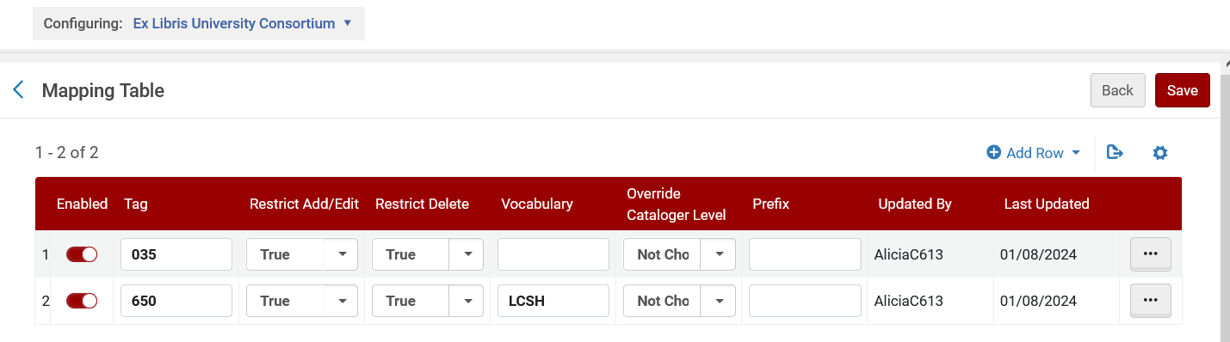
For example
Here is the “Fields restriction policy” table now

Slide 20
For example
Now to test this a cataloger at member institution “Open University” will open record MMSID 992830400000191 title “Taiwan in pictures / Alison Behnke with forward by Alicia Chen” in the metadata editor

Slide 21
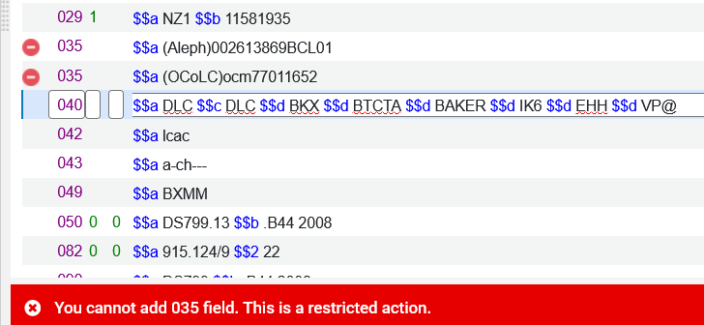
For example
Here is the record now in the metadata editor (part 1 of 2)
We cannot delete or edit the 035 fields and there is a relevant icon next to the fields
This icon means it is a restricted field.
Get this message if we try to add a 035 field

Slide 22
For example
Here is the record in the metadata editor (part 2 of 2)
We cannot edit or delete the 650 field when it uses vocabulary LCSH (2nd indicator 0)
We can edit or delete this 650 field because it is not LCSH
There is no restriction red circular icon here as we had for the 035 because the space is already taken up by a different icon.

Slide 23
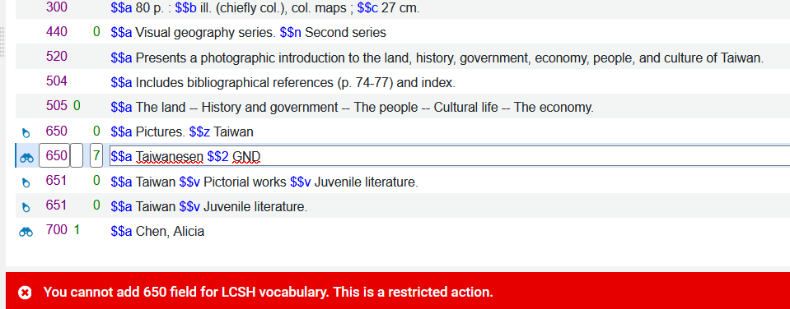
For example
If we try to add another 650 field with 2nd indicator 0 we get this message:

Slide 24
Using the prefix for the restriction of the 035 field

Slide 25
Using the prefix for the restriction of the 035 field
Our record has two 035 fields, and we could not add a new one or edit either existing one
Prefix “Aleph”
Prefix “OCoLC”

Slide 26
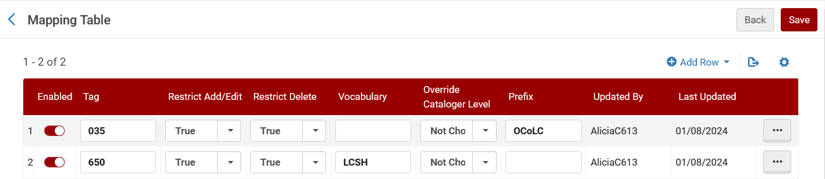
Using the prefix for the restriction of the 035 field
Now in table “Fields Restriction Policy” we have stated that the restriction on the 035 field is only when there is a prefix OCoLC

Slide 27
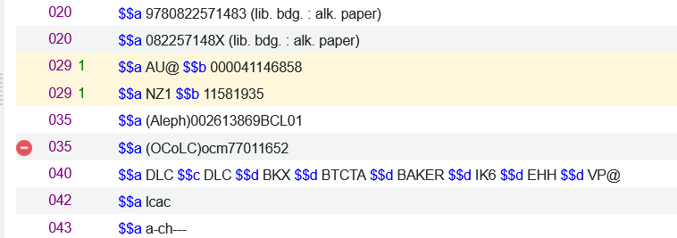
Using the prefix for the restriction of the 035 field
Now only the 035 with the prefix “OCoLC” is restricted
The 035 with a prefix that is not OCoLC is not restricted

Slide 28
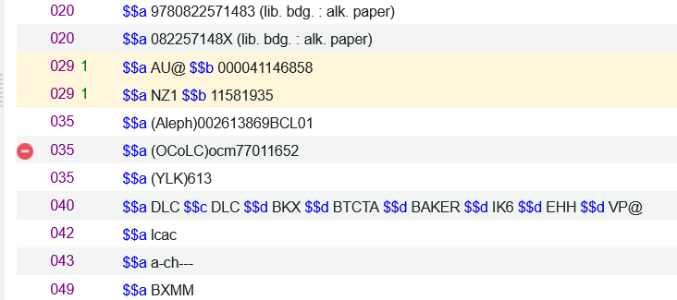
Using the prefix for the restriction of the 035 field
Now we can add a 035 with a prefix which is not “OCoLC”

Slide 29
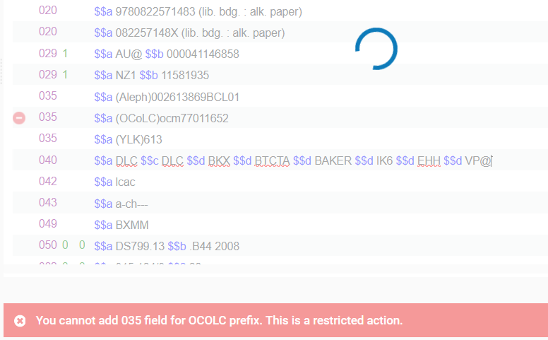
Using the prefix for the restriction of the 035 field
But we cannot add a 035 field which has prefix OCoLC

